Slide 1
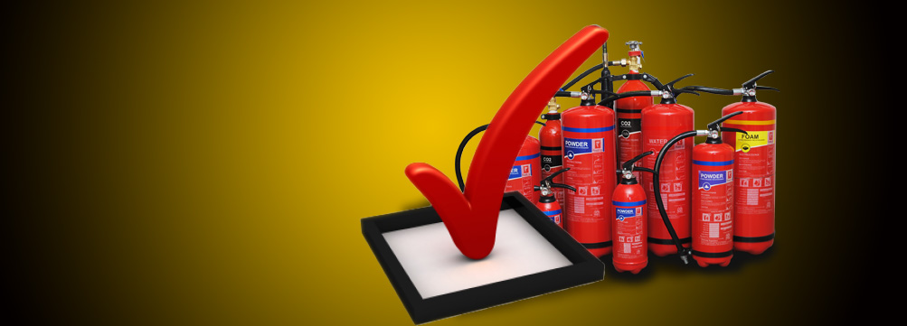
Fire Extinguisher Training PPT
(Everything you wanted to know about fire but afraid to ask)
RAKSHA CONSORTS
Tel. No. : + 91 9391494999 Fax : 0891-4811213
Email : rakshaconsorts@gmail.com Web : www.rakshaconsorts.in

Slide 2
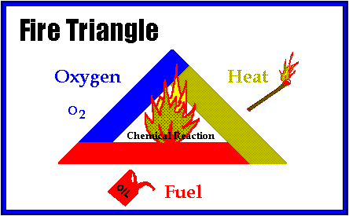
The Fire Triangle
Fire Safety, at its most basic, is based upon the principle of
keeping fuel sources and ignition sources separate.

Slide 3
The Fire
Three things must be present at the same time to produce fire:
Enough OXYGEN to sustain combustion +
Enough HEAT to reach ignition temperature +
Some FUEL or combustible material =
Together, they produce the CHEMICAL REACTION , that is FIRE.
Take away any one of these things and the fire will be extinguished

Slide 4
Fuel Classifications
Fires are classified according to the type of fuel that is burning.
If you use the wrong type of fire extinguisher on the wrong class of fire, you might make matters worse.
Its very important to understand the four different fire (fuel) classifications…

Slide 5





Fuel Classifications
Class A: Combustible Solids-Wood, paper, cloth, trash, plastics—solids that are not metals.
Class B: Flammable liquids—gasoline, acetone, oil, grease, petrol, etc.
Class C: Flammable Gases-LPG, CNG, Acetylene & Energized electrical equipments, as long as it’s “plugged in.”
Class D: Metals—potassium, sodium, aluminium, magnesium. Requires Special Dry Powder and other special extinguishing agents.

Slide 6
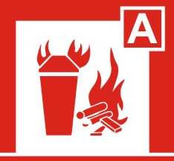
Fuel Classifications
Most fire extinguishers will have a pictograph label telling you which types of fire the extinguisher is designed to fight.
For example, a simple water extinguisher might have a label like this…
…which means it should only be used on Class A fires.

Slide 7
Types of Fire Extinguishers
Different types of fire extinguishers are designed to fight different classes of fire.
The 4 most common types of fire extinguishers are:
Water - For ‘A’ Class Fires
Foam – For ‘A’ & ‘B’ Class Fires
Powder (BC)– For ‘B’ & ‘C’ Class Fires Powder (ABC)- For ‘A’, ‘B’ & ‘C’ Class Fires
CO2 – For ‘B’, ‘C’ Class & Electrical Fires

Slide 8
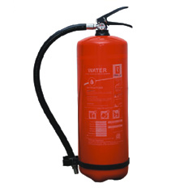
Water Stored Pressure Fire Extinguishers
Water, the best fire extinguishant suited for combating fires involving ordinary carbonaceous materials like wood, paper, cloth, rubber & jute. Water extinguishes fire rapidly by striking, instant cooling & quenching effects.
CAUTION: Using water on a flammable liquid fire could cause the fire to spread.
Using water on an electrical fire increases the risk of electrocution. If you have no choice but to use a W/Co2 on an electrical fire, make sure the electrical equipment is un-plugged or de-energized.
Water Fire extinguisher is designed for Class A
fire only such as: Wood, paper, cloth & combustible material.
It will be found in older buildings, particularly in public hallways, Textiles & Wood Industries / Godowns.
Water extinguishes fire by taking away the “heat” element of the Fire Triangle.

Slide 9
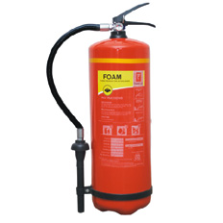
Foam Stored Pressure Fire Extinguishers
Foam is a powerful knockdown agent for spill fires involving inflammable liquids. This extinguisher forms a thick later of foam over the burning surface, effectively cutting of atmospheric supply of oxygen to the burning surface there by smothering the fire and preventing re-ignition. Foam extinguishes fire by giving blanketing effect.
Foam extinguishes fire by taking away the “heat” & “Oxygen” element of the Fire Triangle.
CAUTION: Using Foam on an electrical fire increases the risk of electrocution. If you have no choice but to use a Foam on an electrical fire, make sure the electrical equipment is un-plugged or de-energized.
Foam is designed for Class A & B fires such as: Petrol, Oil, Naphtha, Paints, Alcohols & Solvents.
Foam will be found in older buildings, particularly in Petrol Pumps, as well as Oil Depots. They will also br found in refineries & Petrochemicals Industries.

Slide 10
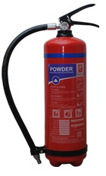
Powder Stored Pressure Fire Extinguishers
ABC Dry chemical extinguishers put out fire by coating the fuel with a thin layer of dust. This separates the fuel from the oxygen in the air.
“ABC” fire extinguishers are filled with a fine yellow powder. The greatest portion of this powder is composed of Mono Ammonium Phosphate chemical. The extinguishers are pressurized with nitrogen.
The powder also works to interrupt the chemical reaction of fire. These extinguishers are very effective at putting out fires.
It is extremely important to identify which types of dry chemical extinguishers are located in your area!
An “ABC” extinguisher will have a label indicating it may be used on Class A, B and C fires.
You don’t want to mistakenly use a “BC” extinguisher on a Class A fire thinking that it was an “ABC” extinguisher.

Slide 11
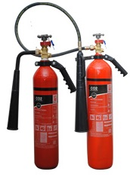
CO2 Fire Extinguishers
The pressure in a CO₂ extinguisher is so great, bits of dry ice may shoot out of the horn!
CO₂s will frequently be found in laboratories, mechanical rooms, Sophisticated Electronic Equipments Room and flammable liquid storage areas.
CO₂ cylinders range in size from 2 Kgs. to 22.5 Kgs. or larger. On larger sizes, the horn will be at the end of a long, flexible hose.
CO₂ is very cold as it comes out of the extinguisher, so it cools the fuel as well.
CO₂’s are designed for Class B & C
(Flammable Liquids and Electrical Sources) fires only!
A CO₂ may be ineffective in extinguishing a Class A fire because it may not be able to displace enough oxygen to successfully put the fire out.
Carbon dioxide is a non-flammable gas that takes away the oxygen element of the fire triangle. Without oxygen, there is no fire.

Slide 12
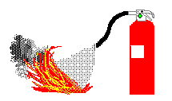
How to Use a Fire Extinguisher
It’s easy to remember how to use a fire extinguisher if you remember the acronym PASS:
Pull
Aim
Squeeze
Sweep

Slide 13
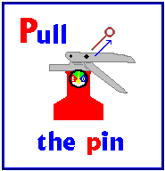
How to Use a Fire Extinguisher
Pull the Safety pin by first breaking the Seal
This will allow you to discharge the extinguisher

Slide 14
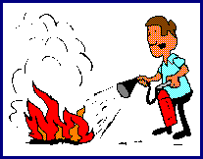
How to Use a Fire Extinguisher
Aim at the base of the fire…
… the extinguishing agent will fly right through

Slide 15
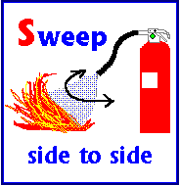
How to Use a Fire Extinguisher
Sweep from side to side…
.. until the fire is completely out.
Start using the extinguisher from a safe distance away, then slowly move forward.
Once the fire is out, keep an eye on the area in case it re-ignites.

Slide 16
Rules for Fighting Fires
Fires can be very dangerous and you should always be certain that you will not endanger yourself or others when attempting to put out a fire. For this reason, when a fire is discovered…
Assist any person in immediate danger to safety, if it can be accomplished without risk to yourself.
Call 101 or activate the building fire alarm. The fire alarm will notify the fire department and other building occupants and shut off the air handling (A.C) system to prevent the spread of smoke.
If the fire is small (and Only after having done these 2 things), you may attempt to use an extinguisher to put it out. However . . . .

Slide 17
Rules for Fighting Fires
. . . before deciding to fight the fire, keep these things in mind:
Know what is burning. If you don’t know what’s burning, you won’t know what kind of extinguisher to use.
Even if you have an ABC fire extinguisher, there may be something in the fire that is going to explode or produce toxic fumes.
Chances are you will know what’s burning, or at least have a pretty good idea, but if you don’t, let the fire department handle it.

Slide 18
Rules for Fighting Fires
. . . before deciding to fight the fire, keep these things in mind:
Is the fire spreading rapidly beyond the point where it started? The time to use an extinguisher is at the beginning stages of the fire.
If the fire is already spreading quickly, it is best to simply evacuate the building.
As you evacuate a building, close doors and windows behind you as you leave. This will help to slow the spread of smoke and fire. Make sure that No one is left inside before you close the doors.

Slide 19
Rules for Fighting Fires
Do not fight the fire if:
You don’t have adequate or appropriate equipment. If you don’t have the correct type or large enough extinguisher, it is best not to try fighting the fire.
You might inhale toxic smoke. When synthetic materials such as the nylon in carpeting or foam padding in a sofa burn, they can produce hydrogen cyanide and ammonia in addition to carbon monoxide. These gases can be fatal in very small amounts.
Your instincts tell you not to. If you are uncomfortable with the situation for any reason, just let the fire department do their job.

Slide 20
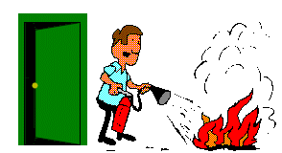
Rules for Fighting Fires
The final rule is to always position yourself with an exit or means of escape at your back before you attempt to use an extinguisher to put out a fire.
In case the extinguisher malfunctions, or something unexpected happens, you need to be able to get out quickly. You don’t want to become trapped.

Slide 21
Our Message To Industries
Fire safety should not remain as a slogan, management must look into it. Fire Safety makes sense from the point of view of economics as well for the healthy environment. All developed countries have found that it is more viable to install Fire Fighting & Safety Systems rather than to bear the losses due to Fire.
Our survey revealed that effective use of well maintained Fire Fighting & Safety Equipments resulted into saving hundreds of Human Lives as well as Property worth Crores of rupees. Every organization can save by going through the Statutory Fire Safety Audit & Following proper procedure & recommendations for the installation of total Safety equipments. This shall Minimize Fire losses & you shall continue your operation with total safety of your man & material.
All companies must organize workshops for their respective dept personnel's with the competent authorities. This way they can help to save the company from Fire losses & Precious Life, ultimately resulting in saving huge amount for the industry & country as a whole.

